Slide 1
RAML

Slide 2
Introduction to RAML
WHAT IS RAML?
RAML stands for RESTful API Modeling Language. RAML is a non-proprietary, vendor-neutral open spec. The aim is to help our current API ecosystem and solve immediate problems, and then gently encourage ever-better API patterns.
WHY SHOULD I USE RAML FOR MY API?
To get a well-defined contract in a human-readable format to actually exist as your source code.
API's structure is manifest and easily understood by everyone: developers, partners, and other API-consumers.
The Application Programming eXperience, or APX, vastly improves with the knowledge that there is a formal, versioned, crystal-clear contract that reflects the structure of the API and is independent of implementation.
Well-designed and manifestly-structured APIs, with a lot of internal consistency based on explicit patterns, lead to easier and more robust client coding and server implementations.

Slide 3

Features of RAML
Design
Designing an API is easy. With RAML you are able to take advantage of the full API Design Lifecycle, meaning that you can design your API visually, test it, and get user feedback without ever having to write a single line of code.
Code Reuse
Prototype Your REST API
Perfect Your REST API
Tools that can be used for designing RAML are API Workbench , API Designer etc.

Slide 4

Features of RAML Contd..
Build
RAML makes it easy to build your API by turning your spec into code with server-side generators in several different languages including NodeJS, Java, .NET, and Python
Restlet
With Restlet Framework's powerful routing and filtering capabilities, unified client and server Java API, developers can build secure and scalable RESTful web APIs.
RAML for JAX-RS
The goal of RAML for JAX-RS is to provide a set of tools to work with these technologies to build your API in a way of being able to scaffold a JAVA + JAX-RS application based on an existing RAML API definition.
Osprey
Osprey is a JavaScript framework for rapidly building applications that expose RAML APIs. It’s based on Node and Express.

Slide 5

Features of RAML Contd..
Testing
Testing Made Easy using RAML. Unit Tests are absolutely crucial to ensuring that your API doesn’t have any backwards compatibility breaks and meets all of your current requirements.
Postman
Postman is one of the most popular API calling and testing tools used by developers today. Freely available as a Chrome app, Postman supports API calls to any RESTful API and lets you setup scripts and tests after importing your RAML spec.
Abao
Abao is a NodeJS command-line tool for testing API documentation written in RAML format against its backend implementation.
Vigia
Vigia is an adaptable API integration test suite which supports test generation based on a RAML definition file.

Slide 6
Features of RAML Contd..
Documentation
RAML makes documenting your REST API easy, and even better keeps your API documentation in sync! With hundreds of open source tools like the API Console, API Notebook, and RAML 2 HTML documentation can be generated quickly and on the fly.
Share & Support your API
The great thing about RAML is that it not only lets you design your API, but actually defines your API.
This means that this very same RAML spec can be used to integrate your API with other systems, and even generate SDKs for today’s most popular languages.

Slide 7
Designing APIs
Objectives:
Define an API with RAML, the Restful API Modeling Language.
Mock an API to test its design before it is built.
Publish the API
Consume the API

Slide 8
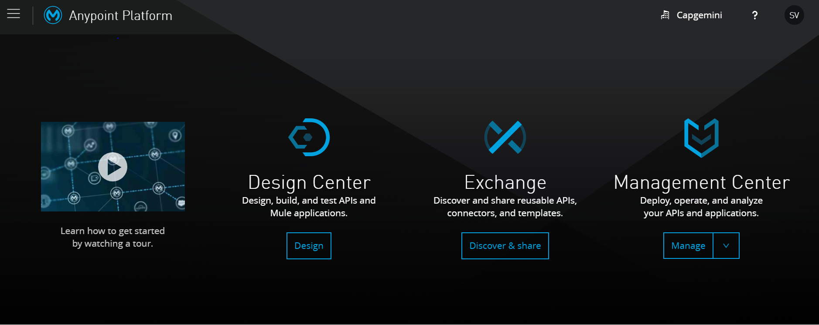
To Design an API
Prerequisites
To create an API in Anypoint Platform, you need an account . If you do not have an account, you can sign up for a free one.
https://anypoint.mulesoft.com/login/#/signin
After login in you be redirected to the page as shown below.
.

Slide 9
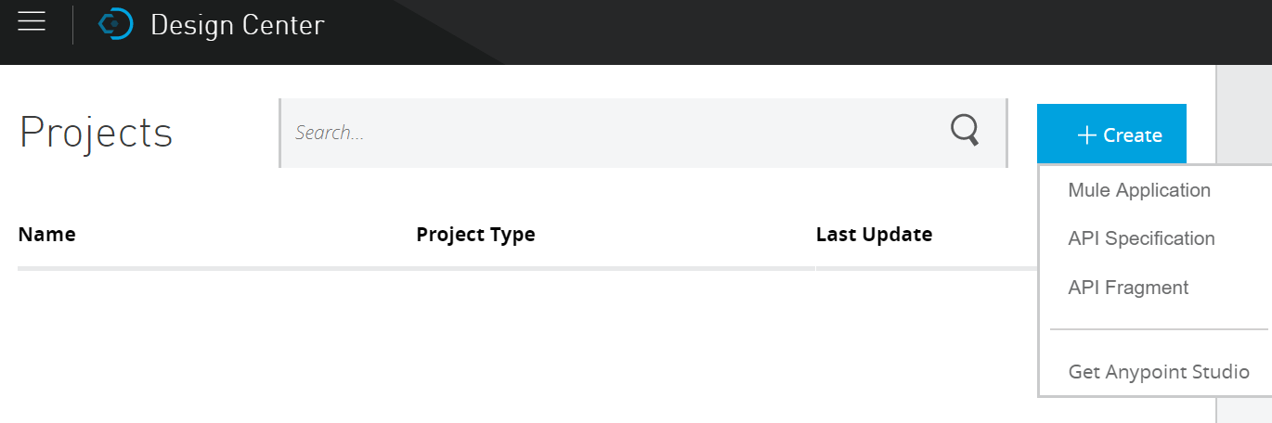
Design Center
In Anypoint Platform, click Design Center. Set up a project to create a new API specification:
In Projects, click Create. Select API Specification.
In New API Specification, type a name for your new project

Slide 10
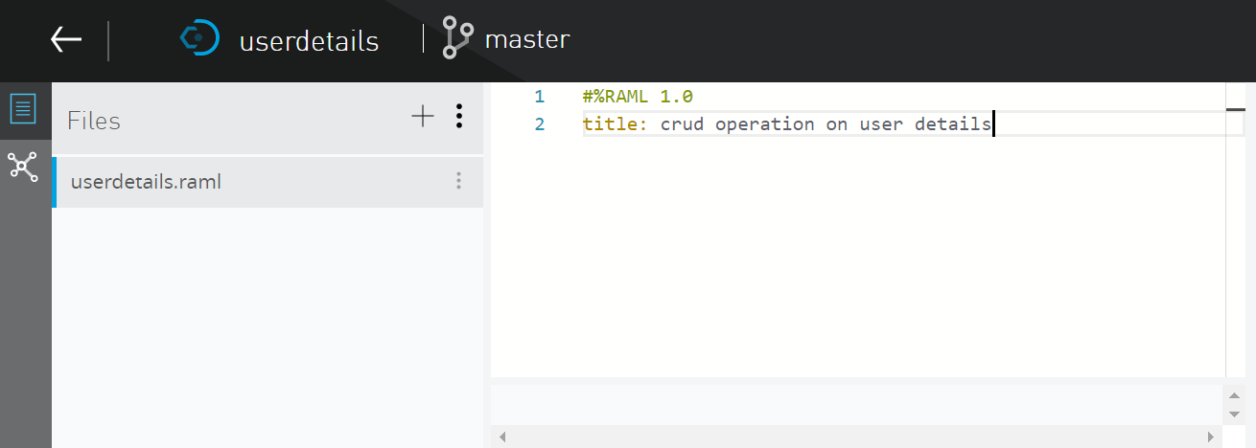
Design Center Contd..
After successful creation of project you would be redirected on to the raml file that you have created. Here I have created the project as userdetails.
A short, plain-text label for the API
The first line of a RAML API definition document MUST begin with the text #%RAML followed by a single space followed by the text 1.0 and nothing else before the end of the line.

Slide 11
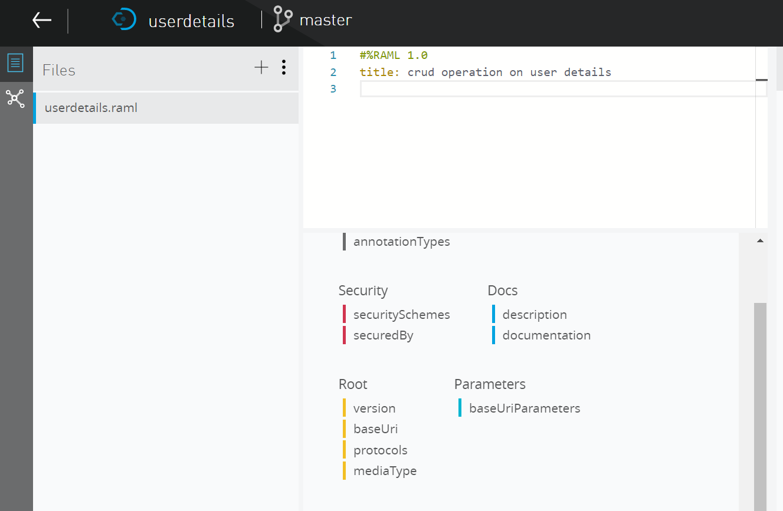
The root of the document
Root | Description
version | The version of the API, for example "v1". Its value is a string
baseUri | A URI that serves as the base for URIs of all resources
protocols | The protocols supported by the API
mediaType | The default media types to use for request and response bodies

Slide 12
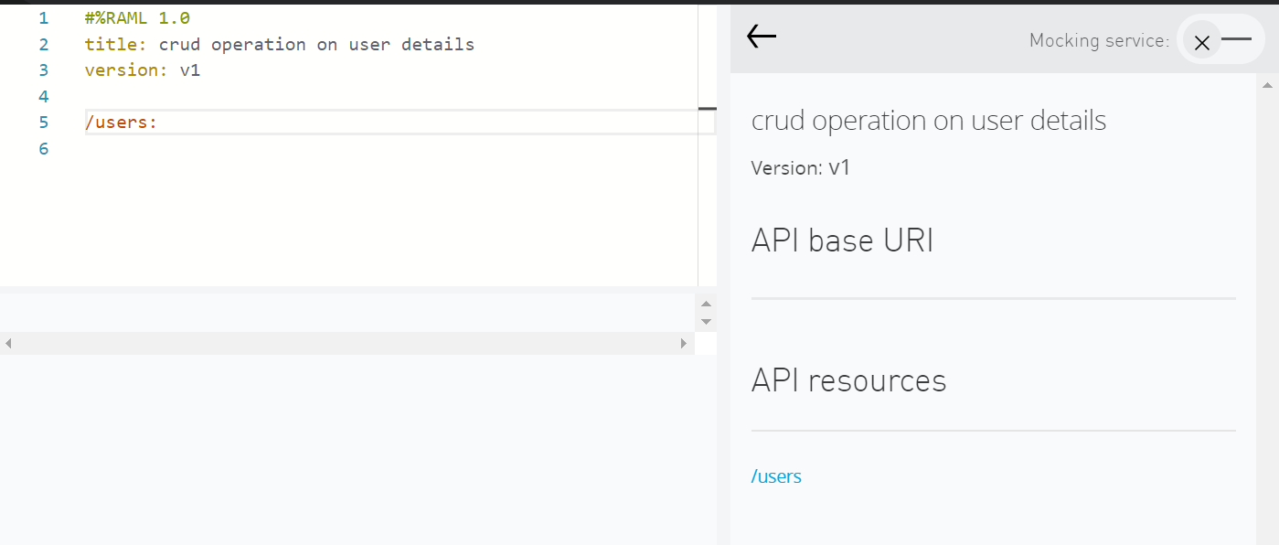

Add a RAML resource
Place the cursor on a new line of code at the end of the file.
Add a resource called users.
/users:
At the right-side of the window will be see the resource users

Slide 13
Add RAML methods
In the API Designer editor, go to a new line of code.
Indent by pressing the Tab key.
Press the G key and then the Enter key to add a get method.
Look at the right side window; you should see a GET tab for the users resource.
In the editor, press the Enter key and then the P key.
In the popup that appears, select post and then press Enter.

Slide 14
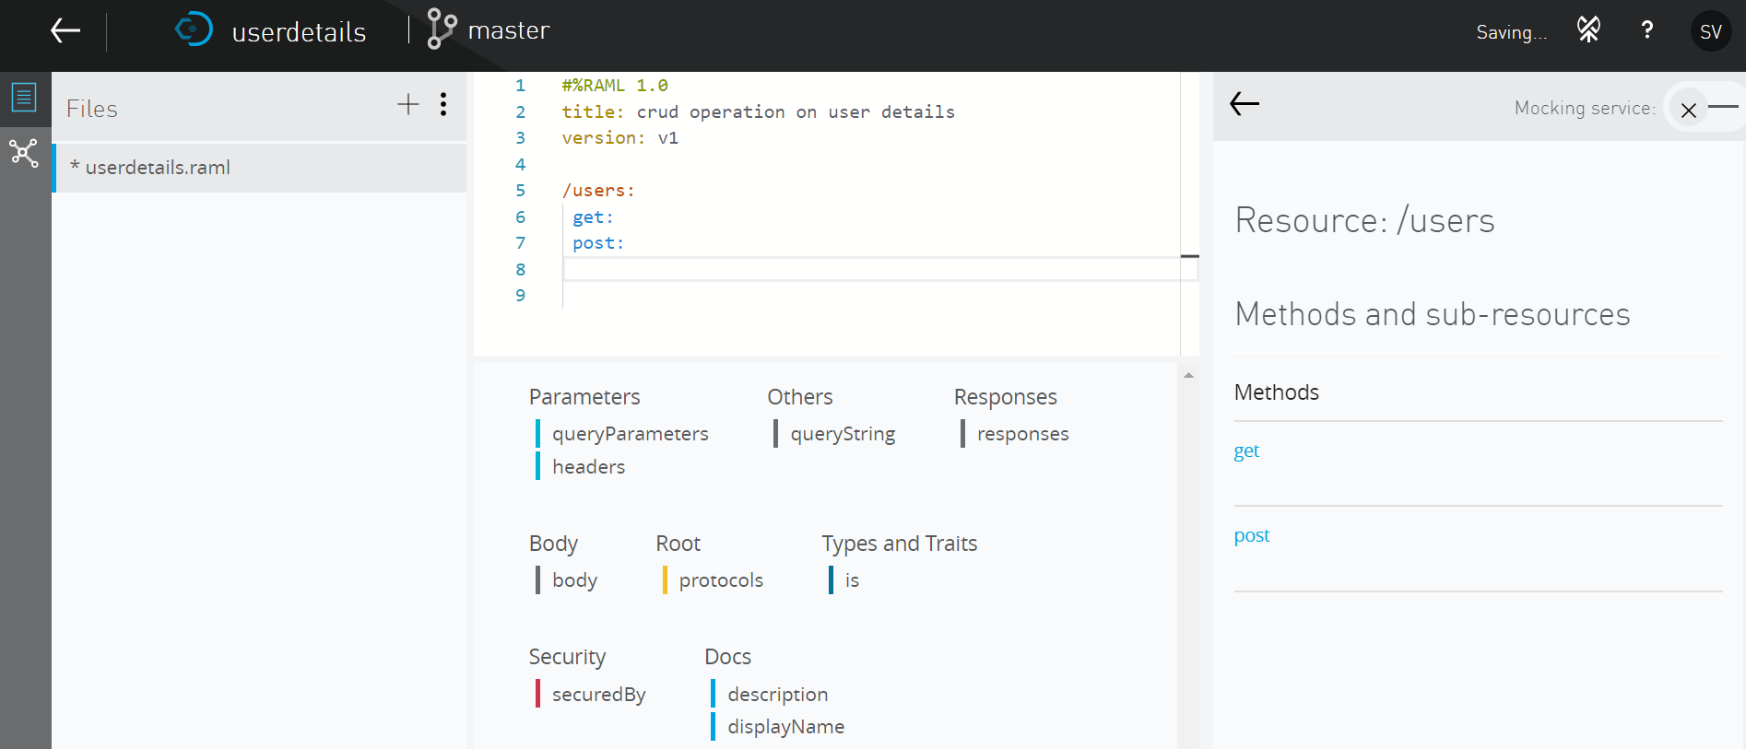
Add RAML methods Contd..

Slide 15
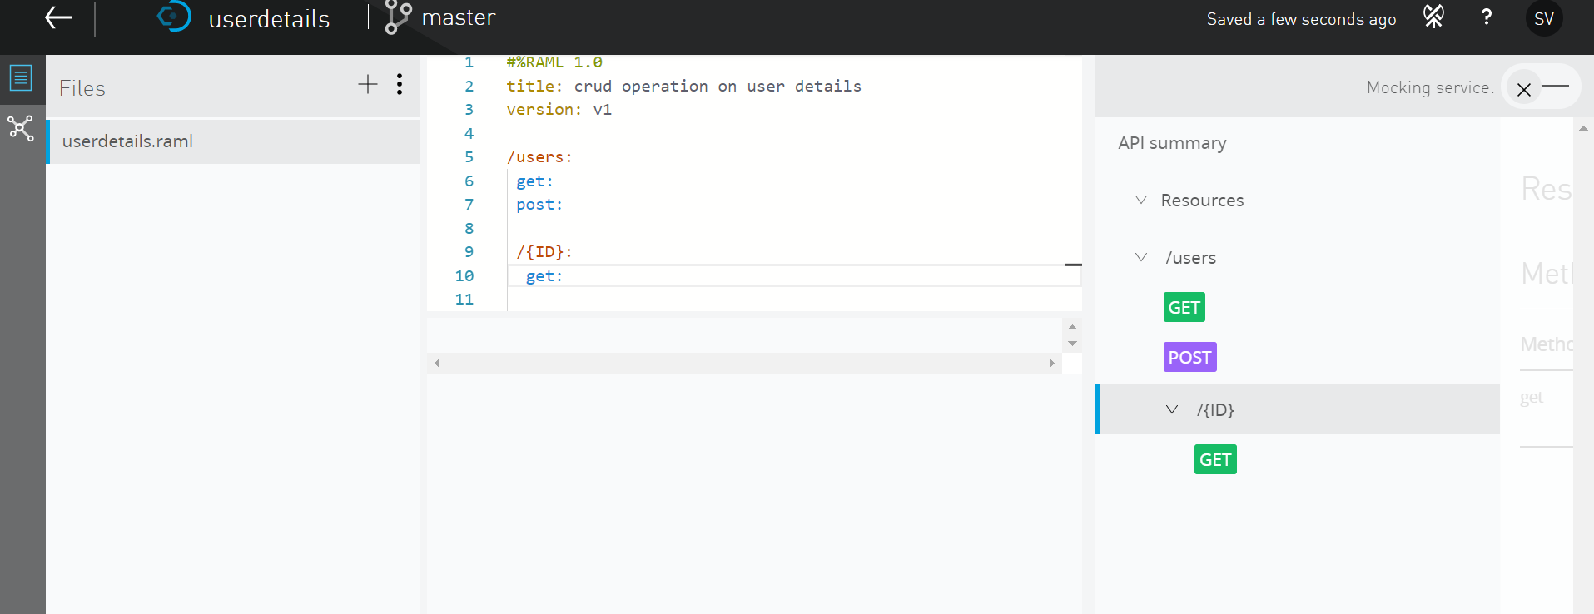
Add a nested RAML resource
In the editor, press Enter twice.
Make sure you are still under the users resource (at the same indentation as the methods).
Add a nested resource for a user with a particular ID.

Slide 16
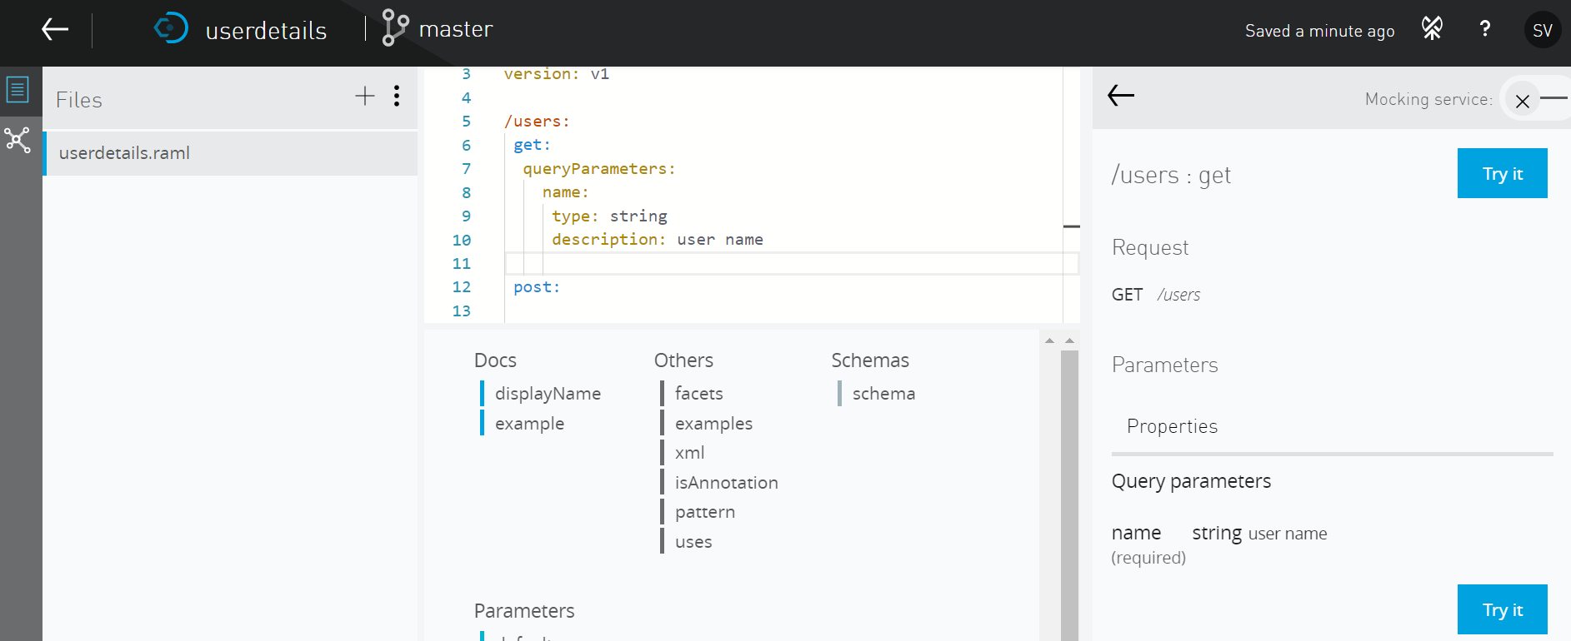
Add a query parameter
In the editor, indent under the /users get method (not the /users/{ID} get method).
In the API Designer click queryParameters.
Indent and add a key named name

Slide 17
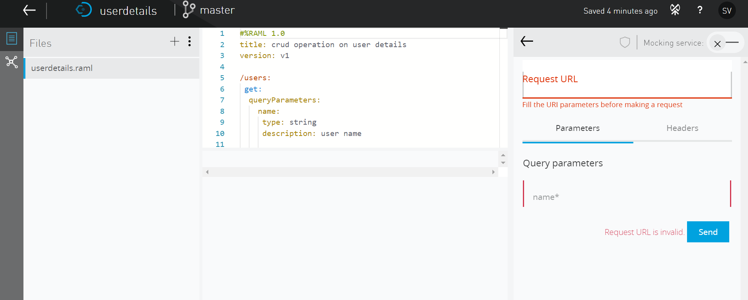
Calling an API method
Click on try you will be prompted for a url. Since the mocking service is not enabled there is no baseUri .Enable the mocking service on top right corner.

Slide 18
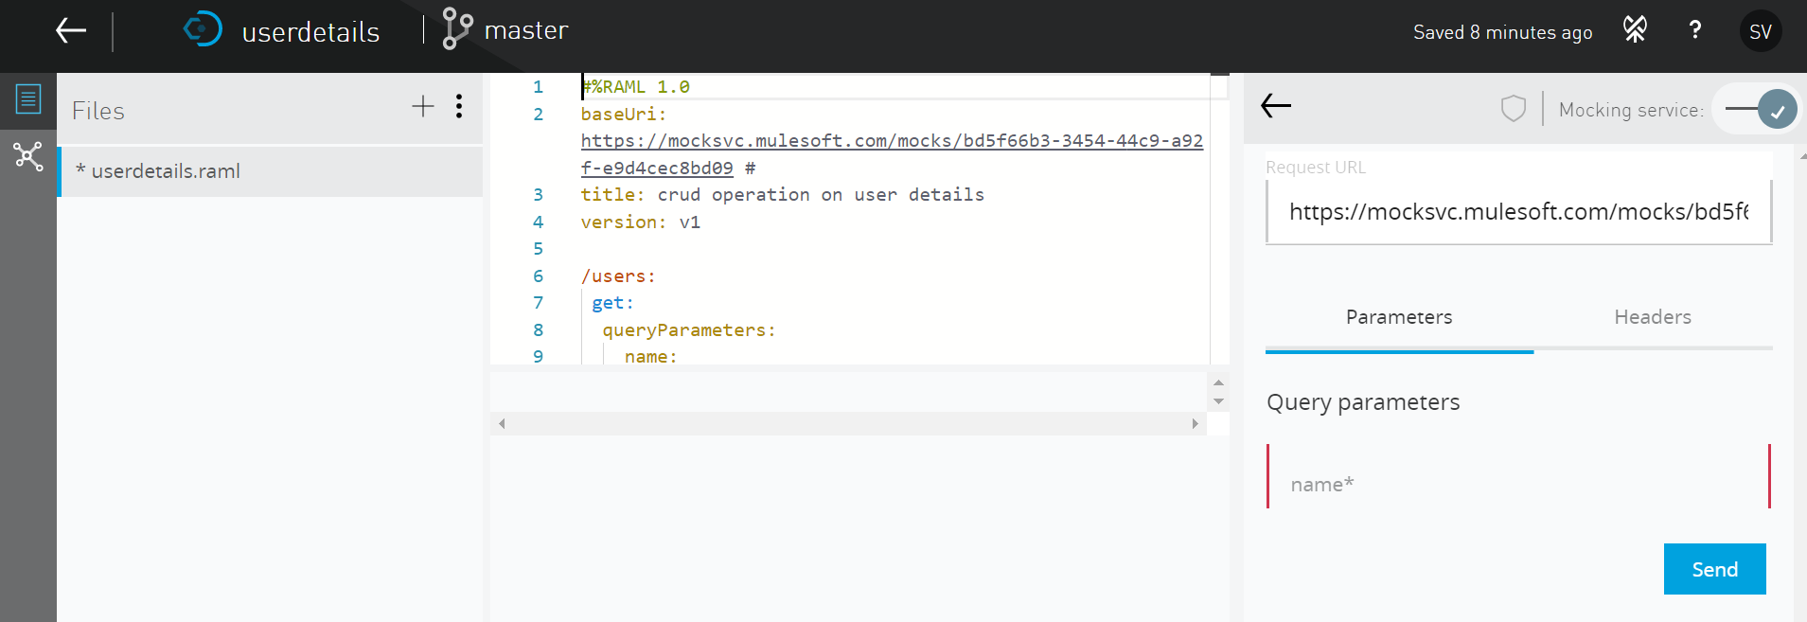
Calling an API method Contd..

Slide 19
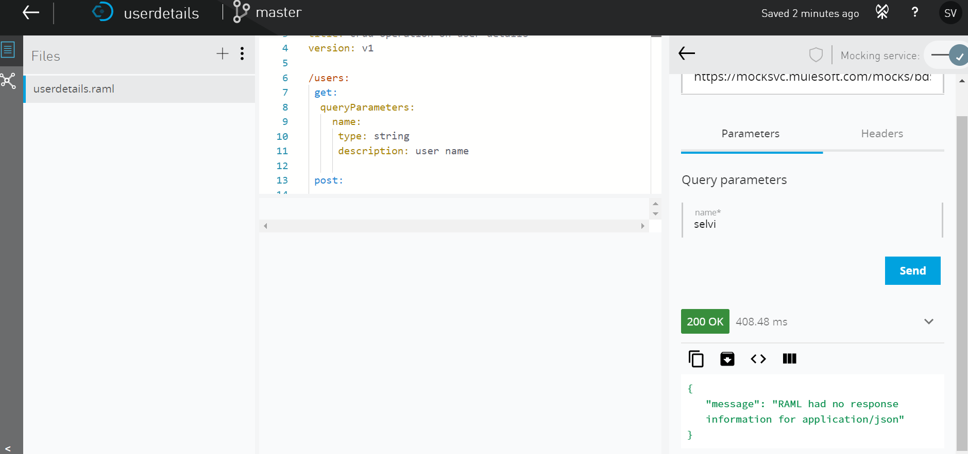
Test /users
Status Code
Response body

Slide 20
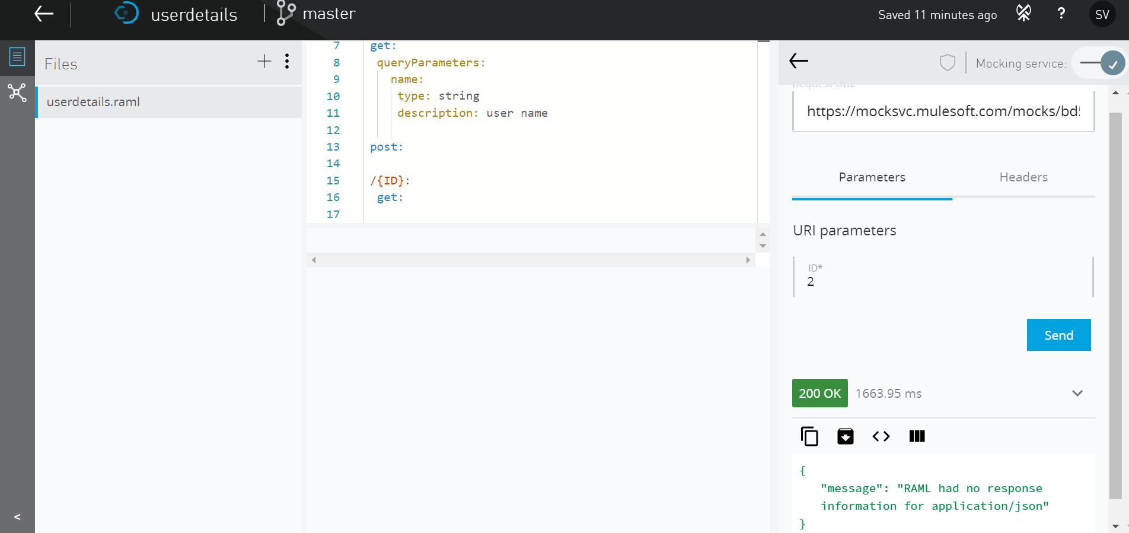
Test /users/{ID}
URI Parameter
Status Code
Response body

Slide 21
Add request and response details
In this walkthrough, you add information about each of the methods to the API definition. You will:
Specify data types for get and post method responses.
Add example JSON responses.
Specify possible query parameter values.
Test the API and get the sample responses.

Slide 22
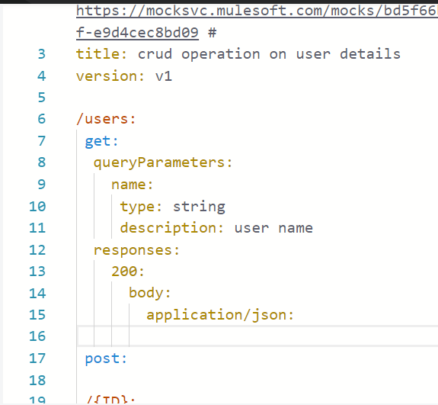
Specifying the response for /users get method
Indent under the /users get method (at the same level as queryParameters).
In the API Designer click responses.
Indent and add a 200 response
Indent and add a body parameter.
Indent and add application/json.

Slide 23
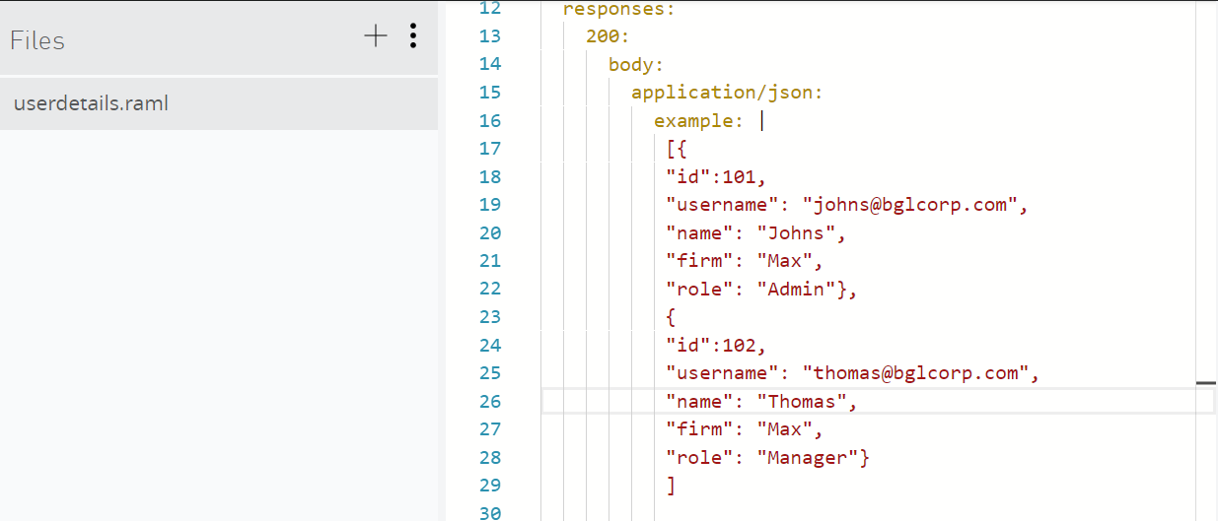
Add sample data for the /users get method
Indent and add an example element.
Add a space and then a | after the example element.

Slide 24
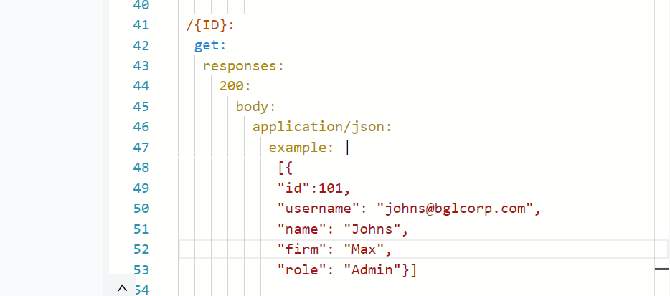
Specify details for the /users/{ID} get method
For the /users/{ID} get method, add a 200 response with application/json data.

Slide 25
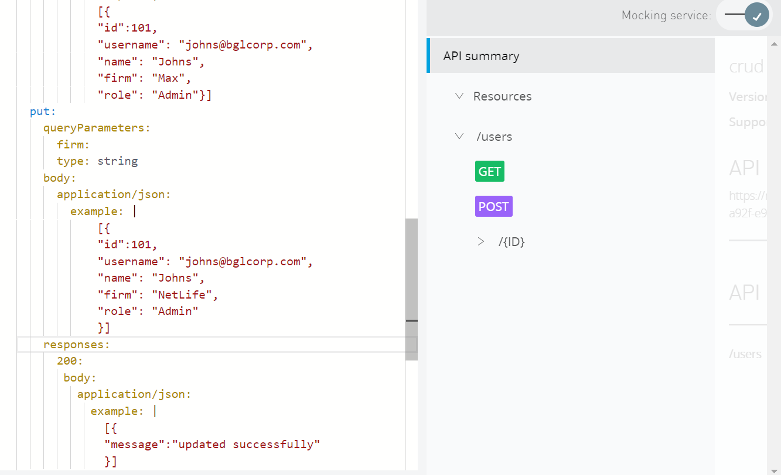
Specify details for the /users/{ID} put method

Slide 26
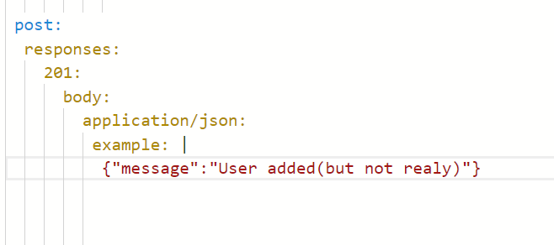
Specify details for the /users post method
For the /users post method, add a 201(created) response with application/json data.
Indent under application/json and add an example element with a space and then a | after it.

Slide 27
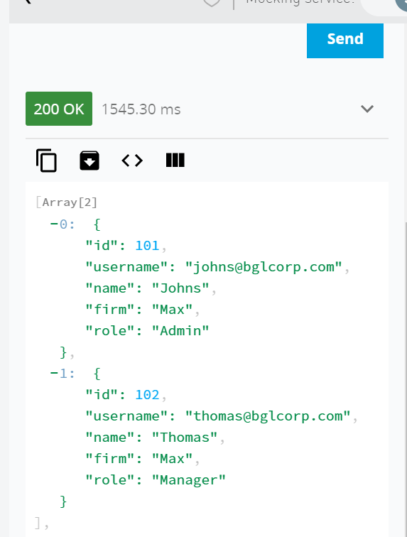
Get the sample data when making calls to the mocked API
Click the GET tab for the users resource again and hit on try and the parameter and click on send
Json response with status code 200

Slide 28
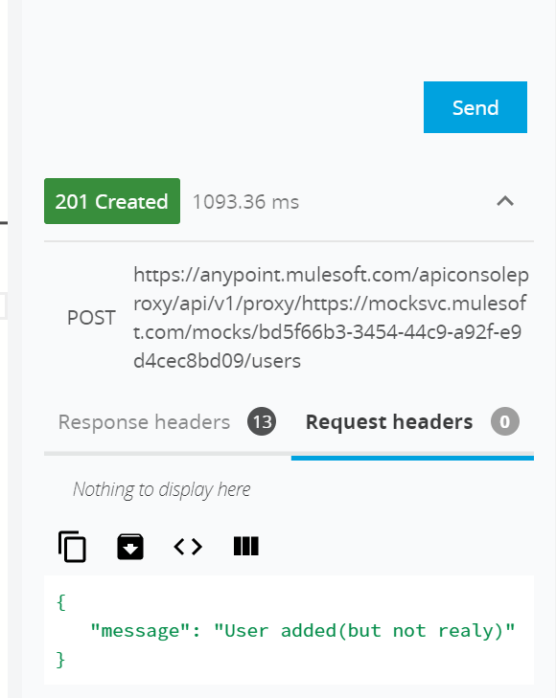
Get the sample data when making calls to the mocked API
Click the POST tab for the users resource. Click on try and then send.
Look at the request section and notice there is no information about the data that should be sent
with the request – the data to be posted.
Lets specify details for /users post method

Slide 29
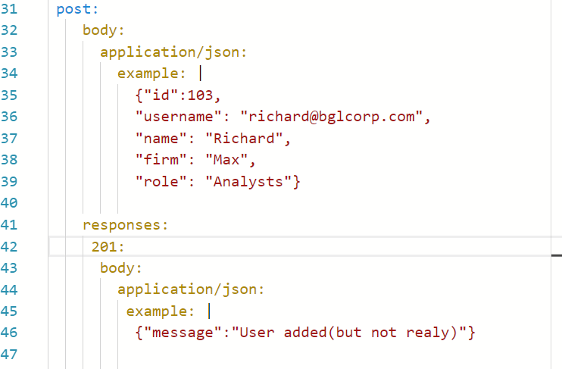
Specifying the response for /users post method
Indent directly under the /users post method so you are above and at the same level as responses.
Add a body element.
Indent and add application/json.
Indent and add an example element with a space and then a | after it.

Slide 30
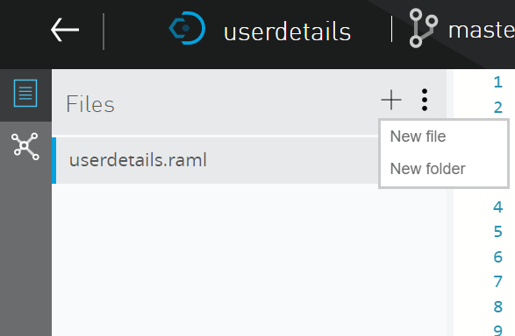
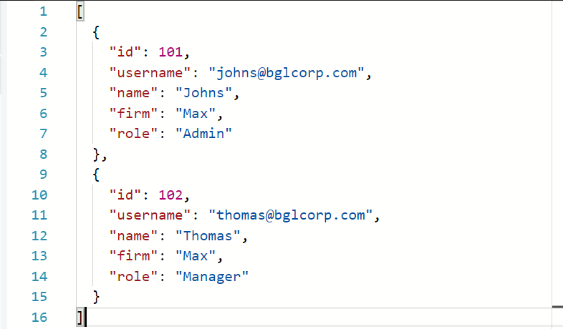
Use of include
We can include the external files using include.
Let us add the json added in /users get method to user.json file.
Create a new file named as user.json and add the below content

Slide 31
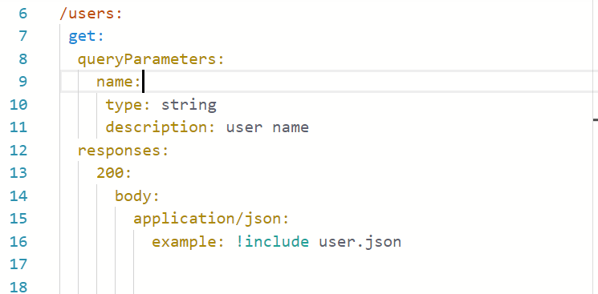
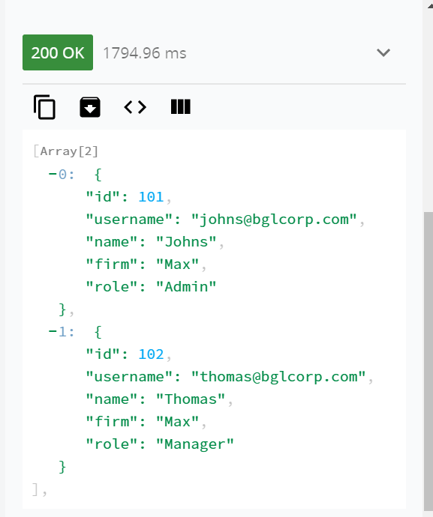
Use of include Contd..
Mocking the /users get method returns the json response which is included in user.json

Slide 32
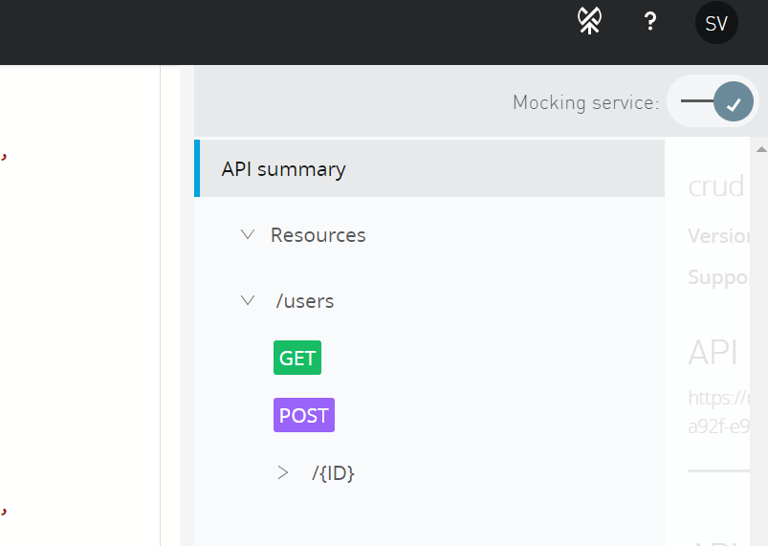
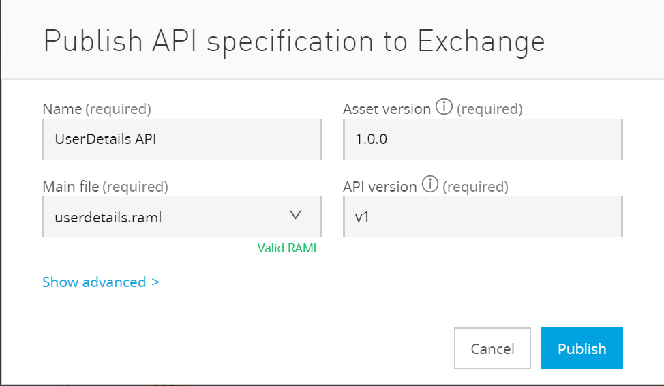
Publishing API
Click on the icon to publish the API
Click on publish after filling details

Slide 33
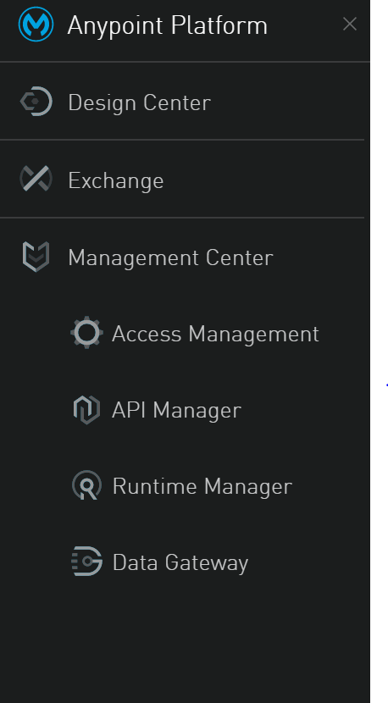
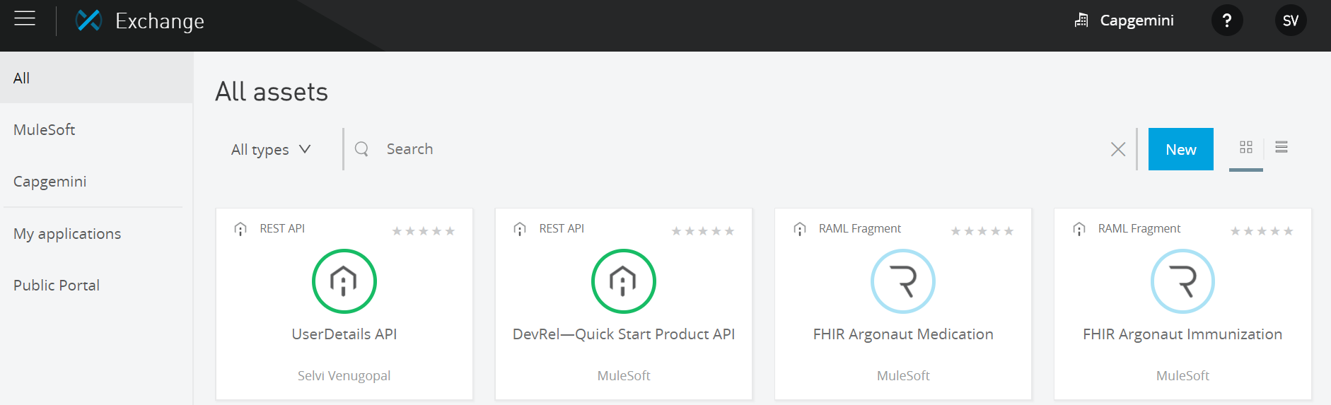
API published to the exchange
API published to the exchange
and available for consumption

Slide 34
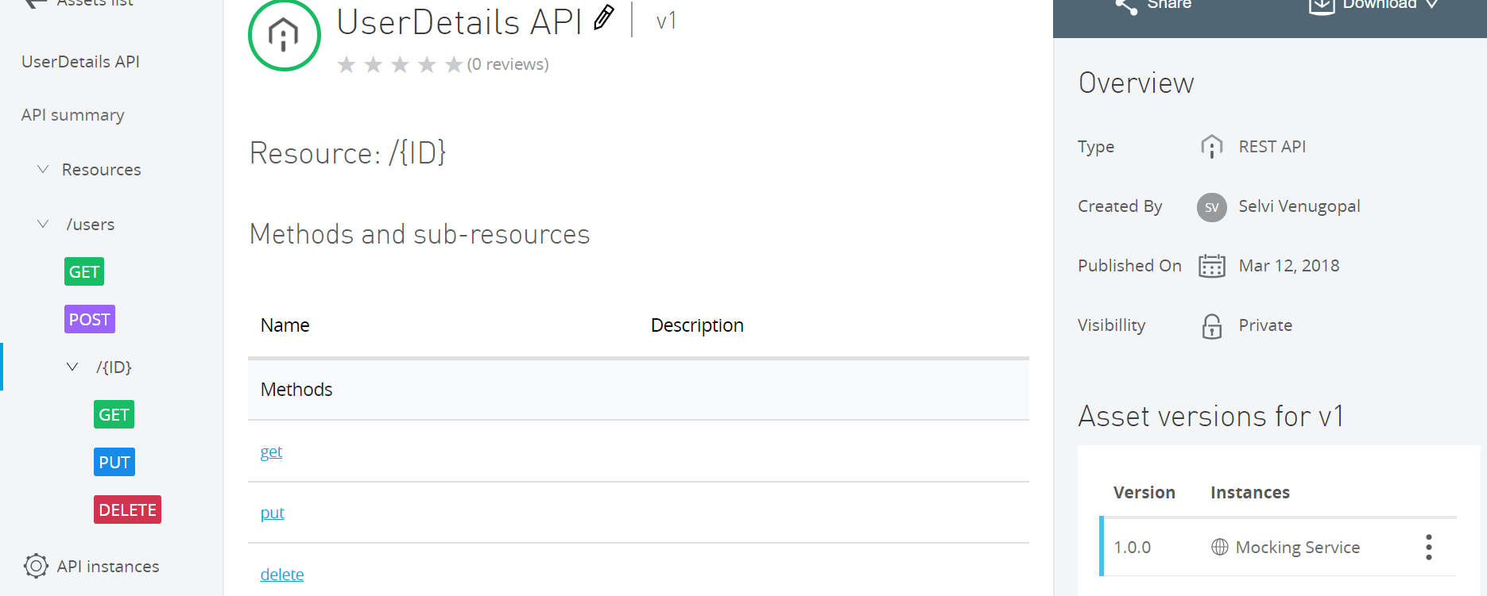
Overview of published API

Slide 35
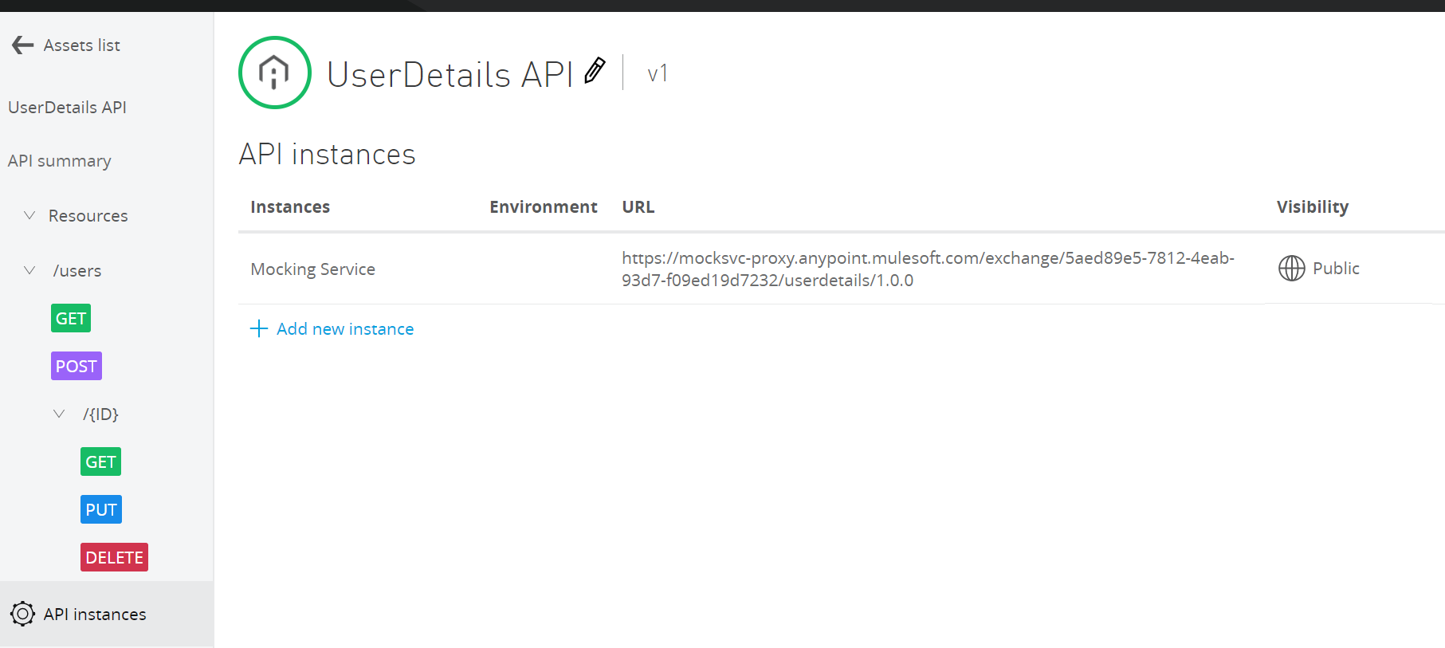
Mocking Service
Mocking service that can be used to test the api through any of the api testing tools eg POSTMAN

Slide 36
Introduction to Swagger
Swagger is one of the most popular API documentation frameworks. It provides a standard, language-agnostic way of defining a REST API interface.
This approach allows the client to understand the capabilities of the REST service without any prior access to the service implementation code or network inspection.
The goal of Swagger is to keep the client, API documentation, and API server implementation insync. The Swagger framework comes with the following:
OpenAPI Specifications for documenting RESTful APIs
Swagger UI to graphically display the API interface
Tools like Swagger Codegen to generate clients for different languages

Slide 37
Swagger Specification
The Swagger specification describes the following information about the REST API.
n URL endpoint
n HTTP verbs supported for the URI
n Description
n Query parameters to be passed in the URL
n Header parameters in the input request message
n Payload format and data type for the request and response messages
n HTTP response status codes
n Security requirements
n Vendor extensions
An API's Swagger specifications are documented in JSON or YAML format.

Slide 38
API Blueprint
API Blueprint is a document-oriented language for describing REST API using Markdown syntax.
API Blueprint Document Structure : An API Blueprint document is structured into logical sections.
The following are the reserved keywords for defining the header and list entities in an API Blueprint document:
Header keywords
Group
Data structure
HTTP methods
URI templates
Combination of HTTP methods and URI templates
List keywords
Request
Response
Body
Schema
Model
Header and headers
Parameter and parameters
Values
Attribute and attributes
Relation

